Slide 1
ASE Scenarios
Scenario 4
ASE User browses warnings generated by ASE Library

Slide 2
Roles
Developer
Tester
Risk Manager
Notes:
I am excluding build manager from this scenario because their discovery is via SDK only.

Slide 3
Goals
User views the warnings generated by ASE Library for the Application resources and/or actions which are risky

Slide 4
Steps
Step 1: Select ASE Profile
Step 2: Make Warnings Pane Visible
Step 3: Browse Warnings
Step 4: View TeamMentor guidance associated with each warning

Slide 5
Step 1
Select ASE Profile
User selects an ASE Profile from the Solution Explorer

Slide 6
Step 2
Make Warnings Pane Visible
Using one of the following methods:
User selects View>>Error List from VS Menu
User selects ASE>>Warnings from ASE Menu
User toggles Warnings icon ON from the ASE Toolbar

Slide 7
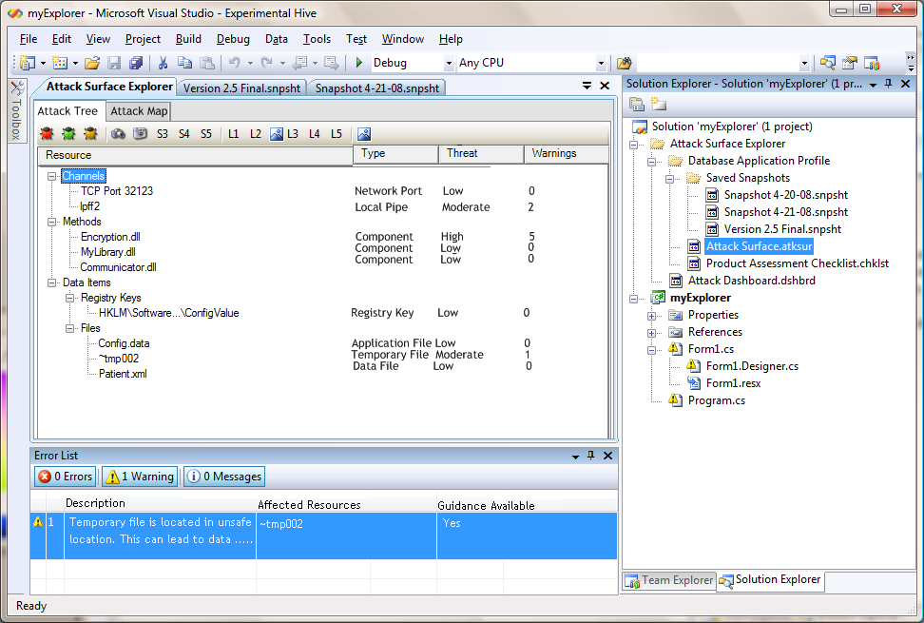
Step 3
Browse Warnings
Each item in the list displays a Description and affected Resources
User can choose to ignore a Warning by right-clicking and selecting ignore
User enters justification for ignoring warning
User dbl-clicks warning item
The main IDE view is changed to the associated ASE Tree and affected Resources are highlighted

Slide 8
Step 3
View TeamMentor guidance associated with each warning
User right-clicks warning item and selects ‘View Guidance’
A guidance HTML page is loaded in the main IDE window
Depending upon TeamMentor subscription status, the content of the guidance varies

